Slide 1
Flutter Session
Hello Again ☺ !!

Slide 2

Outlines
Why state management?
BLoC vs Cubit State management
Cubit usage
Importance of widget tree

Slide 3
Why state management?
Imagine if we have the same example of the to-do application.
In the case where I am going to fetch the data from the database ,I have a few scenarios for the data.
(Loading , get data successfully , error)

Slide 4
Why State management?
As you explore Flutter, there comes a time when you need to share application state between screens, across your app. There are many approaches you can take, and many questions to think about.

Slide 5
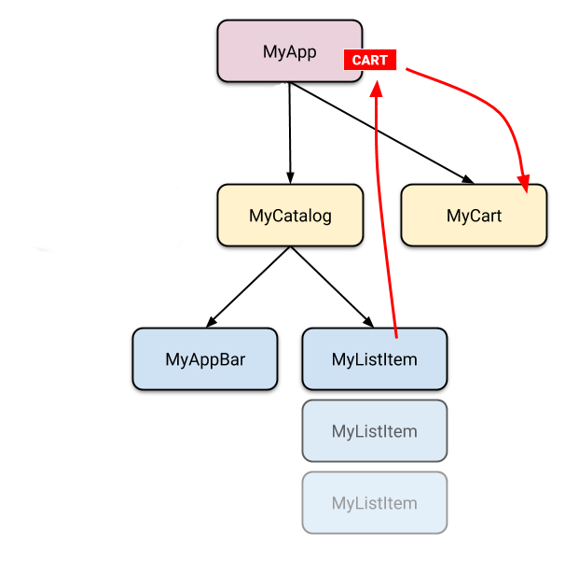
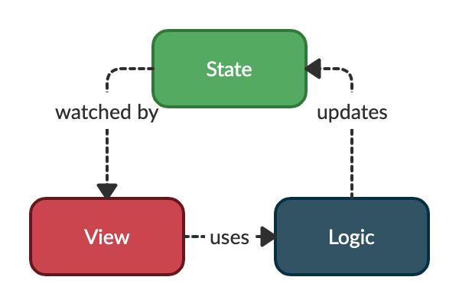
Why state management?

Slide 6

Why state management?
State management is a crucial aspect of building complex applications, including those developed with the Flutter framework. Flutter itself provides a basic mechanism for managing state using its built-in widgets and the concept of "lifting state up." However, as applications grow in size and complexity, managing state becomes more challenging, and that's where state management solutions come into play.

Slide 7
Why State management?
Application scalability: As your application grows in size and complexity, managing state using Flutter's basic mechanisms can become unwieldy. State management solutions offer more advanced techniques, such as reactive programming, streams, or immutable state, which can help you handle state changes more efficiently and scale your application effectively.
Code reusability: State management solutions often provide ways to share and reuse state across different parts of your application. This can be particularly useful when you have common data that needs to be accessed from multiple screens or components. By centralizing the state management, you can avoid duplicating code and ensure consistency throughout your app.
Performance optimization: State management solutions can help optimize performance by minimizing unnecessary UI updates. By tracking changes to the state and updating only the relevant parts of the UI, you can avoid expensive rebuilds and improve the overall performance of your application.
Integration with external services: If your application needs to interact with external services or APIs, state management can provide a convenient way to handle data fetching, caching, and synchronization. By managing the state related to these interactions, you can ensure a consistent and reliable user experience.
Here are some reasons why you might consider using state management in Flutter:
Managing complex and shared state: State management solutions help you manage complex application states that need to be accessed and modified across multiple screens or components. For example, if you have a shopping app with a shopping cart that needs to be accessed and updated from various screens, a state management solution can provide a centralized way to handle this shared state.
Separation of concerns: State management promotes a separation of concerns by separating your business logic from your UI code. This makes your codebase more maintainable, testable, and scalable. With state management, you can encapsulate your business logic in separate classes or layers, making it easier to reason about and modify.

Slide 8
Why bloc?
Bloc is the best and simple way to do state management. We can easily add any type of change to the Flutter application. You can easily learn the concept, no matter what’s your level. You can add this dependency to your project and use it.
Bloc is a design pattern created by Google to help separate business logic from the award layer and authorize a developer to exploit code more efficiently.
A state management library called Bloc was created and maintained by Felix Angelo. It assists developers utensil the Bloc design pattern in their Flutter application. It means that a developer must recognize the state of an app at some time. There should be something on the screen for every interplay with the app to let users know what the incident is incident.

Slide 9
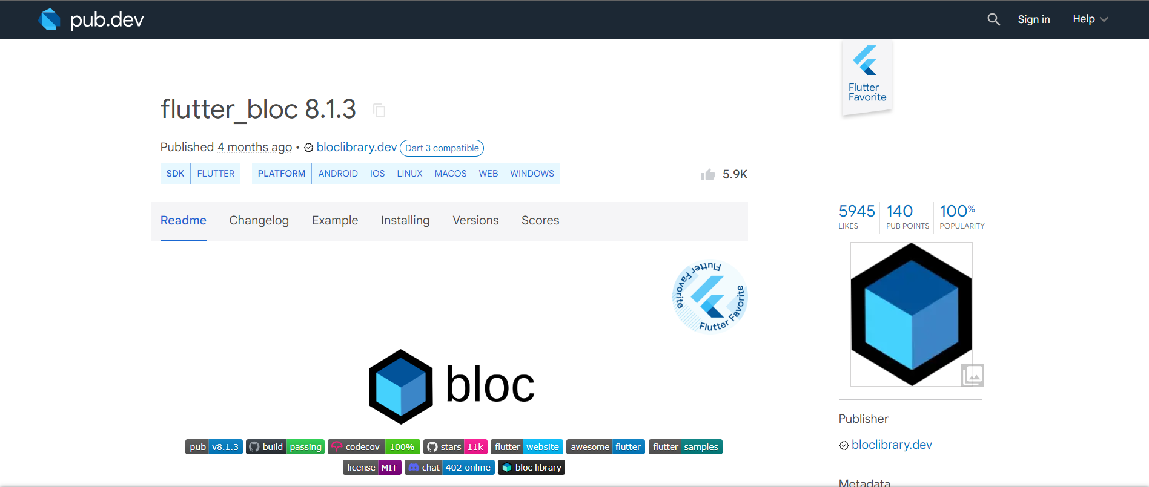
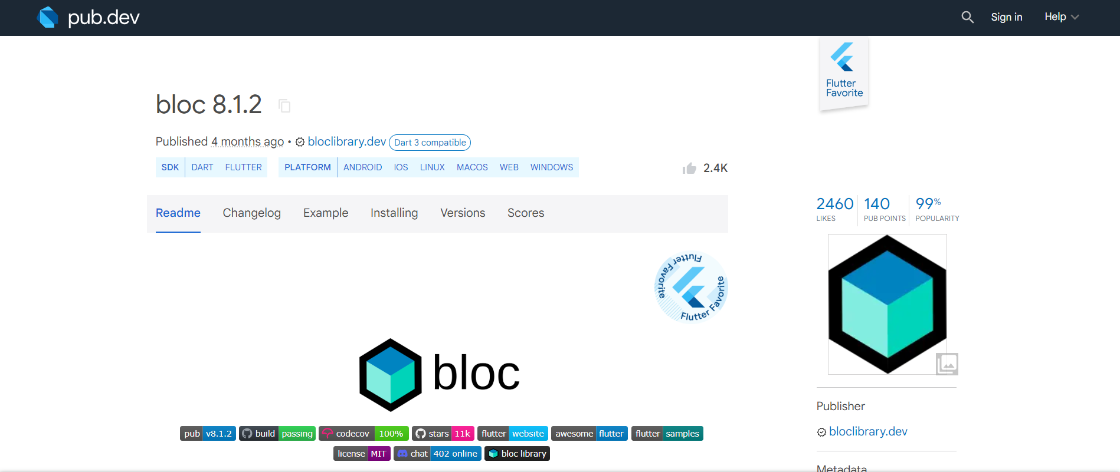
BLoC vs Cubit State management
The two packages that we need to use for using bloc or cubit is flutter_bloc and bloc we can found them on the pub.dev website

Slide 10
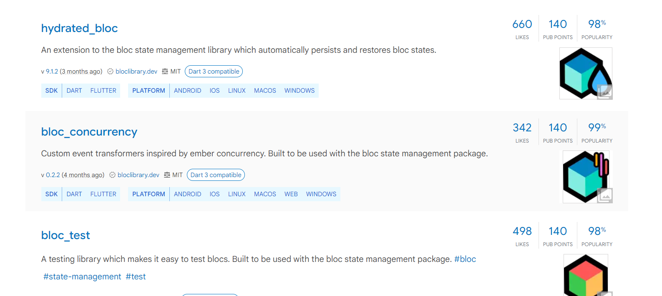
Another packages
The package is very popular on pub dev

Slide 11
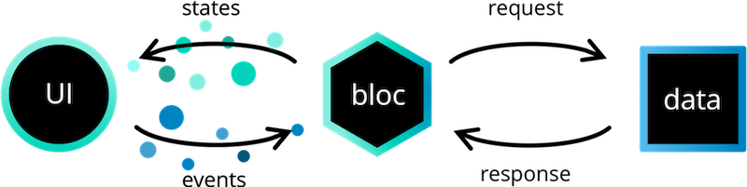
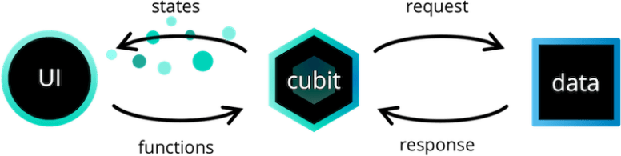
BLoC vs Cubit
The only difference is in the syntax of emitting state. Where Cubit uses emit(event) syntax, State Notifier uses state = event. Bloc on the other hand relies on events instead of functions to get feedback from UI to Cubit. The major difference between Bloc and Cubit is, “Bloc is Event-Driven and Cubit is not Event-Driven”. In Bloc, we can override “onTransition” and check how these events are coming and how these states change. And in Cubit, we call functions to send these states, with the help of these functions we can track the state. We use the “onChnaged” function in Cubit.

Slide 12
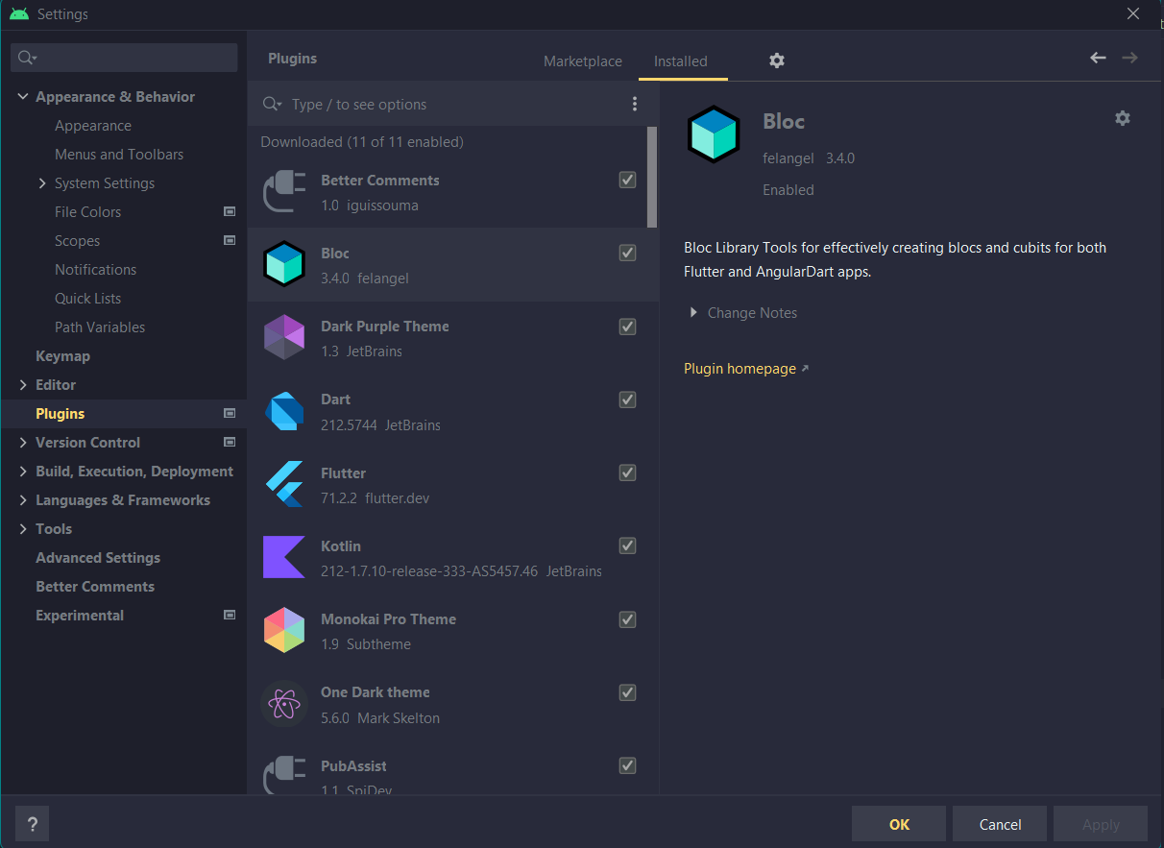
Install this plug-in

Slide 13
Let’s make this app using cubit

Slide 14

How to initialize cubit?

Slide 15
To Use the Cubit
Use the BlocConsumer<CounterCubit,CounterState>

Slide 16

Break!!

Slide 17
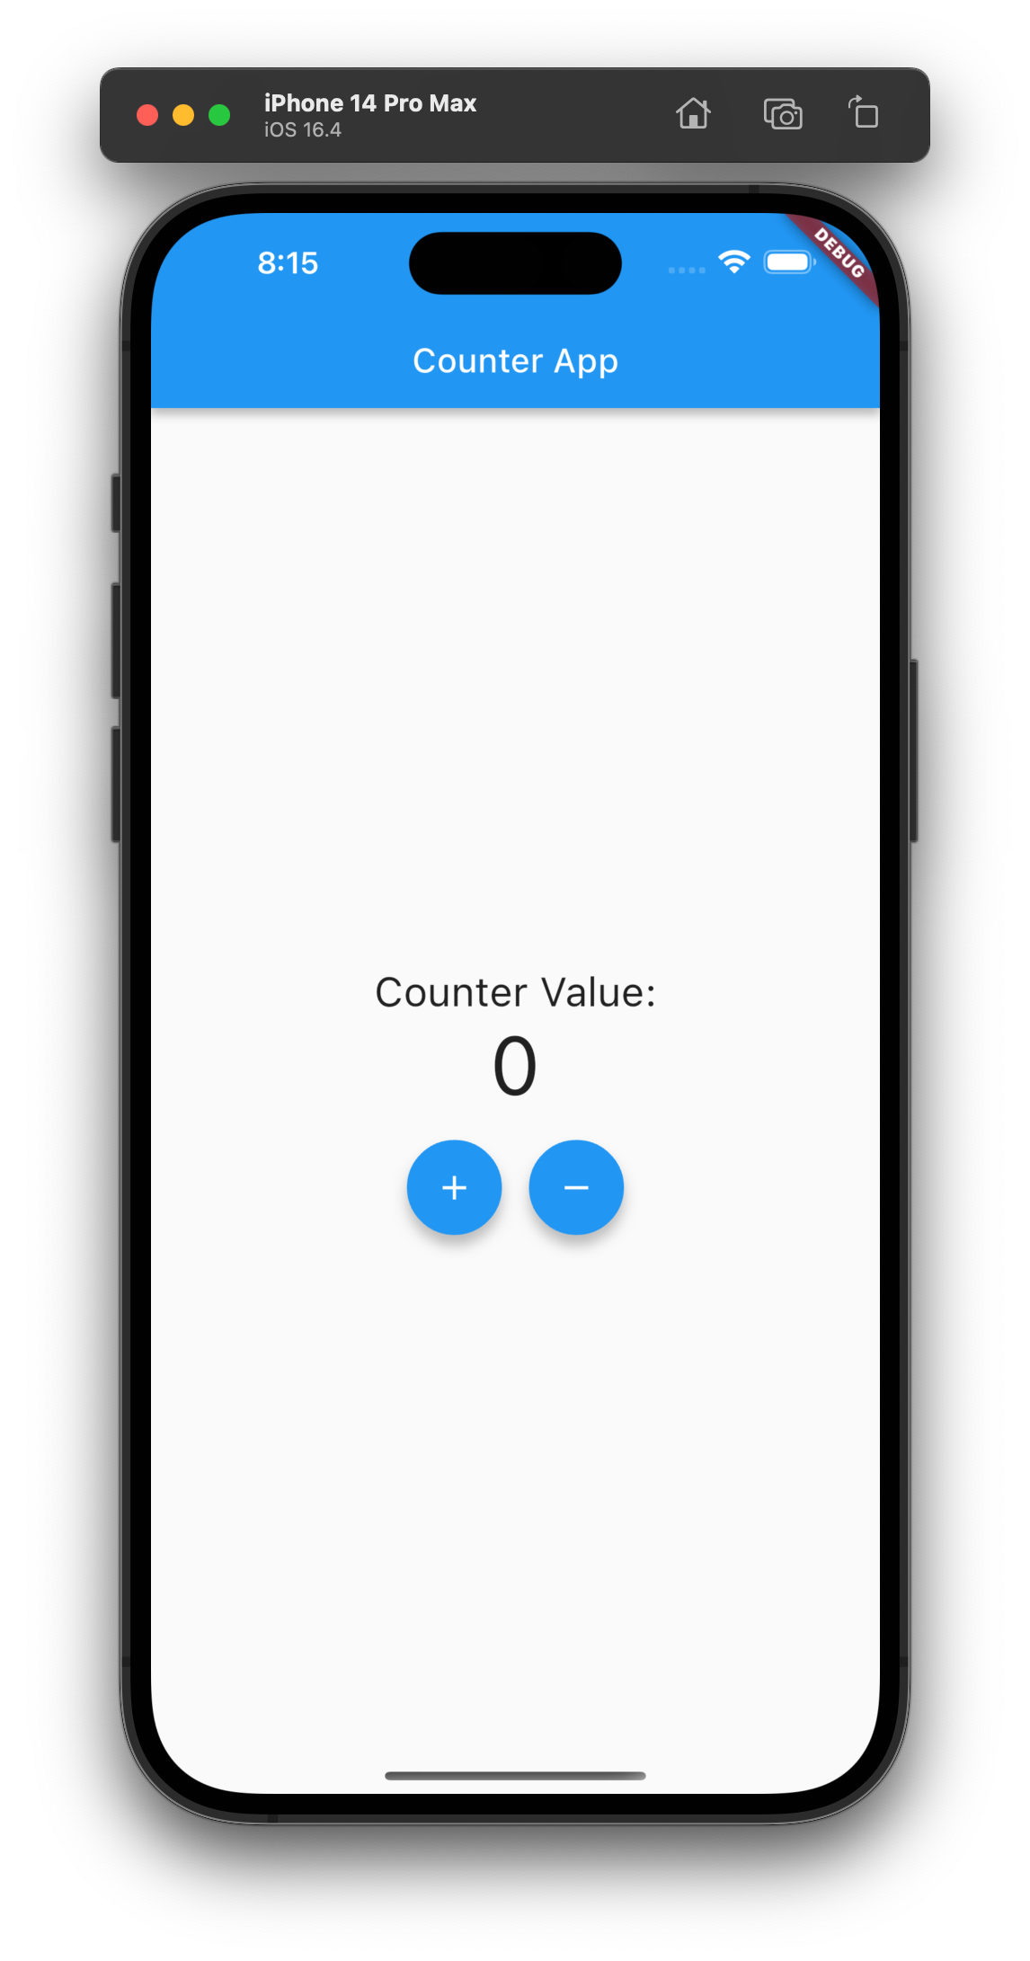
Try yourself

Slide 18
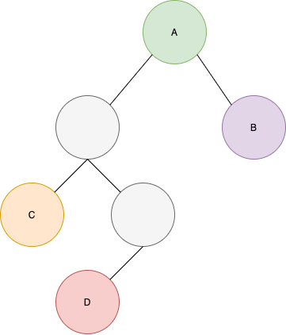
Importance of widget tree

Slide 19
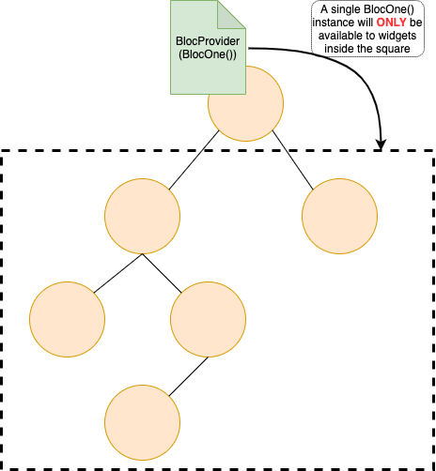
Importance of widget tree

Slide 20
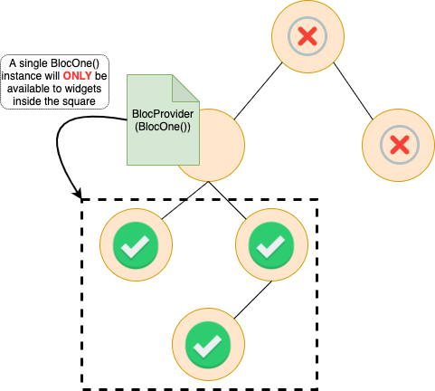
Importance of widget tree

Slide 21

Thank you ☺

